Slide 1
Chapter 26: The Great West and the Agricultural Revolution, 1865–1896

Slide 2
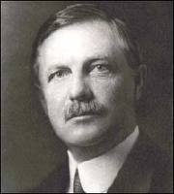
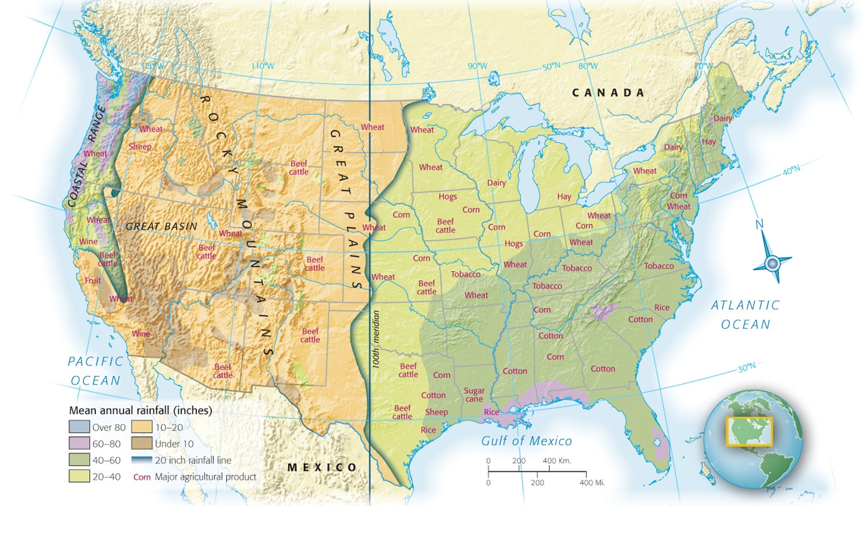
Frederick Jackson Turner
“The Significance of the Frontier in American History”:
Thesis: “Up to our own day American history has been in a large degree the history of the colonization of the Great West. The existence of an area of free land, its continuous recession, and the advance of American settlement westward, explain American development."
Argued closing of the frontier had ended an era in American history.
Used census report of 1890 to explain that settlement of the frontier had created the American character and spurred American development.
Frontier promoted democracy

Slide 3
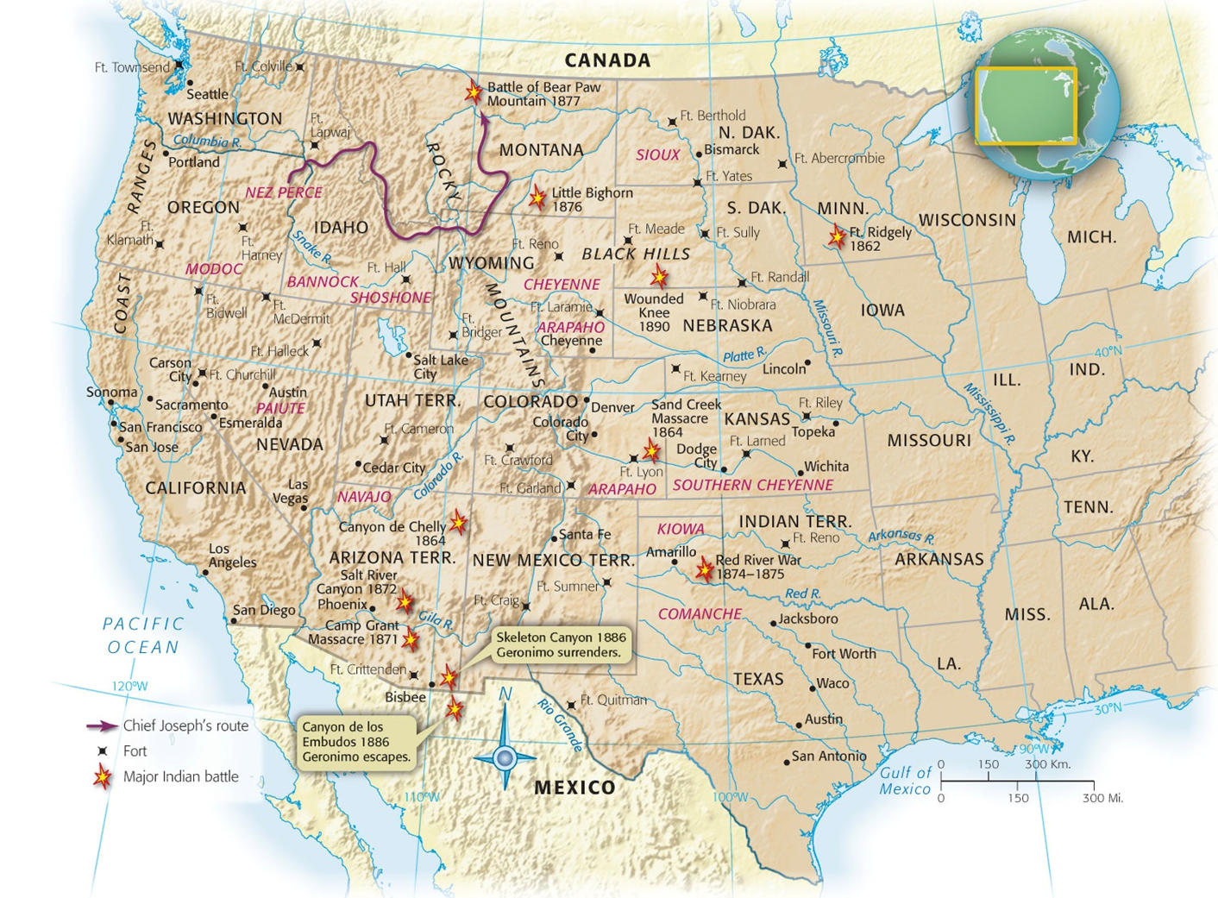
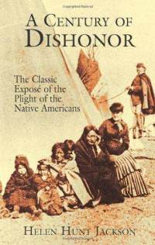
Native Americans
Populations continued to dwindle due to military, railroads, disease, alcohol, fighting, etc.
“bullets, bottles, and bacteria”
Shrinking bison population affected Natives
Nomadic lifestyle
“Buffalo Bill” Cody
US military and Natives engaged in several battles during the late 1800s
Sand Creek, Colorado (1864-Colonel J.M. Chivington’s), Battle of Little Big Horn (1876-Custer), Wounded Knee (1880-“Ghost Dance” Dakota Sioux)
Buffalo Soldier
***Helen Hunt Jackson wrote A Century of Dishonor in 1881***
Chronicled record of government ruthlessness and deceit toward Native Americans

Slide 4
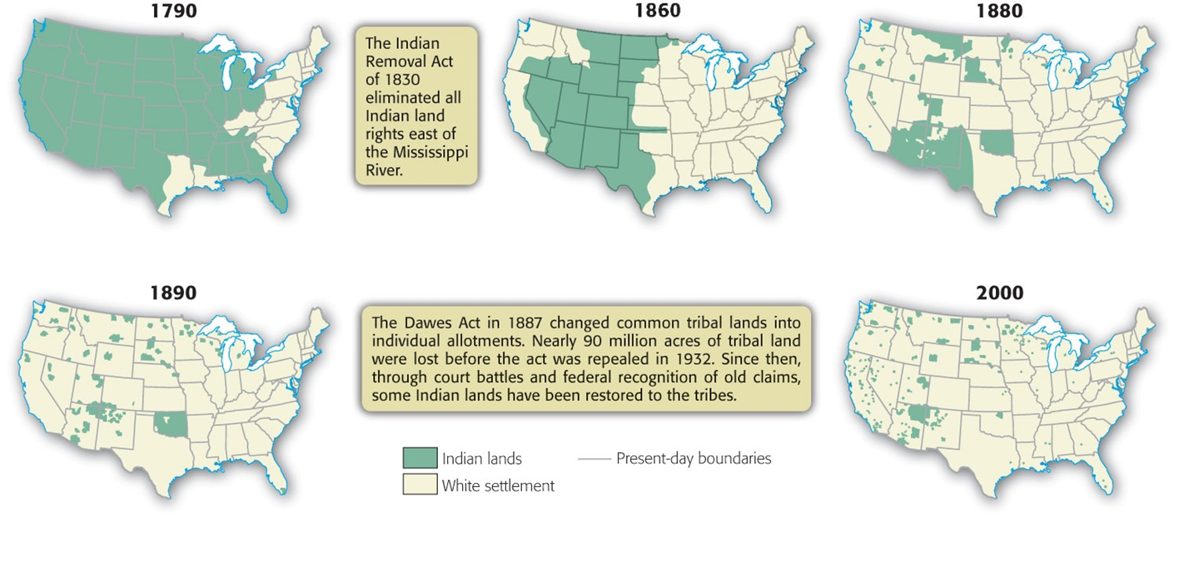
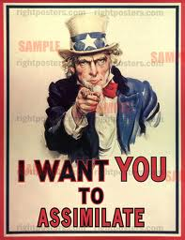
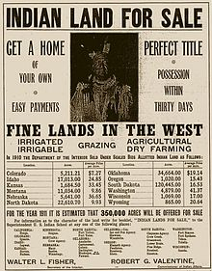
***Dawes Severity Act of 1887***
Dissolved many tribes as legal entities
Wiped out common tribal ownership of land (and reservations)
Set up Indian family heads (NOT tribes) with 160 free acres, receive title and citizenship in 25 years!
Probationary period later extended, but full citizenship granted in 1924!
Impact
Completely altered way of Natives’ lives
Struck directly at tribal organization and tried to make “rugged individualists” out of Indians
Basically, this act tried to “Americanize” Natives, or tried to make them act “white” (Assimilation)
Plains Indians were utterly alien to the concept of living out one’s life in the confinement of a defined territory
Recall, they were nomadic!
Not until 1934 does Federal GOVT reverse individualist approach and restore tribal basis of Indian life.

Slide 5
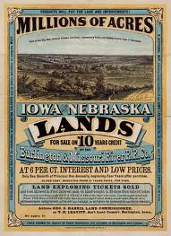
Homestead Act of 1862
Encouraged settlement of western land by:
Granting 160 acres of land by living on it for five years, improving it, and paying small fee of $30
Impact of Act
In theory, favorable to those who could not afford to buy land
500,000 took advantage of it
Many were from Europe (recruited by Rail Road companies)
Land was not always the best: rain-scarce
RR companies created phony people to acquire land
“twelve by fourteen” (inches)

Slide 6
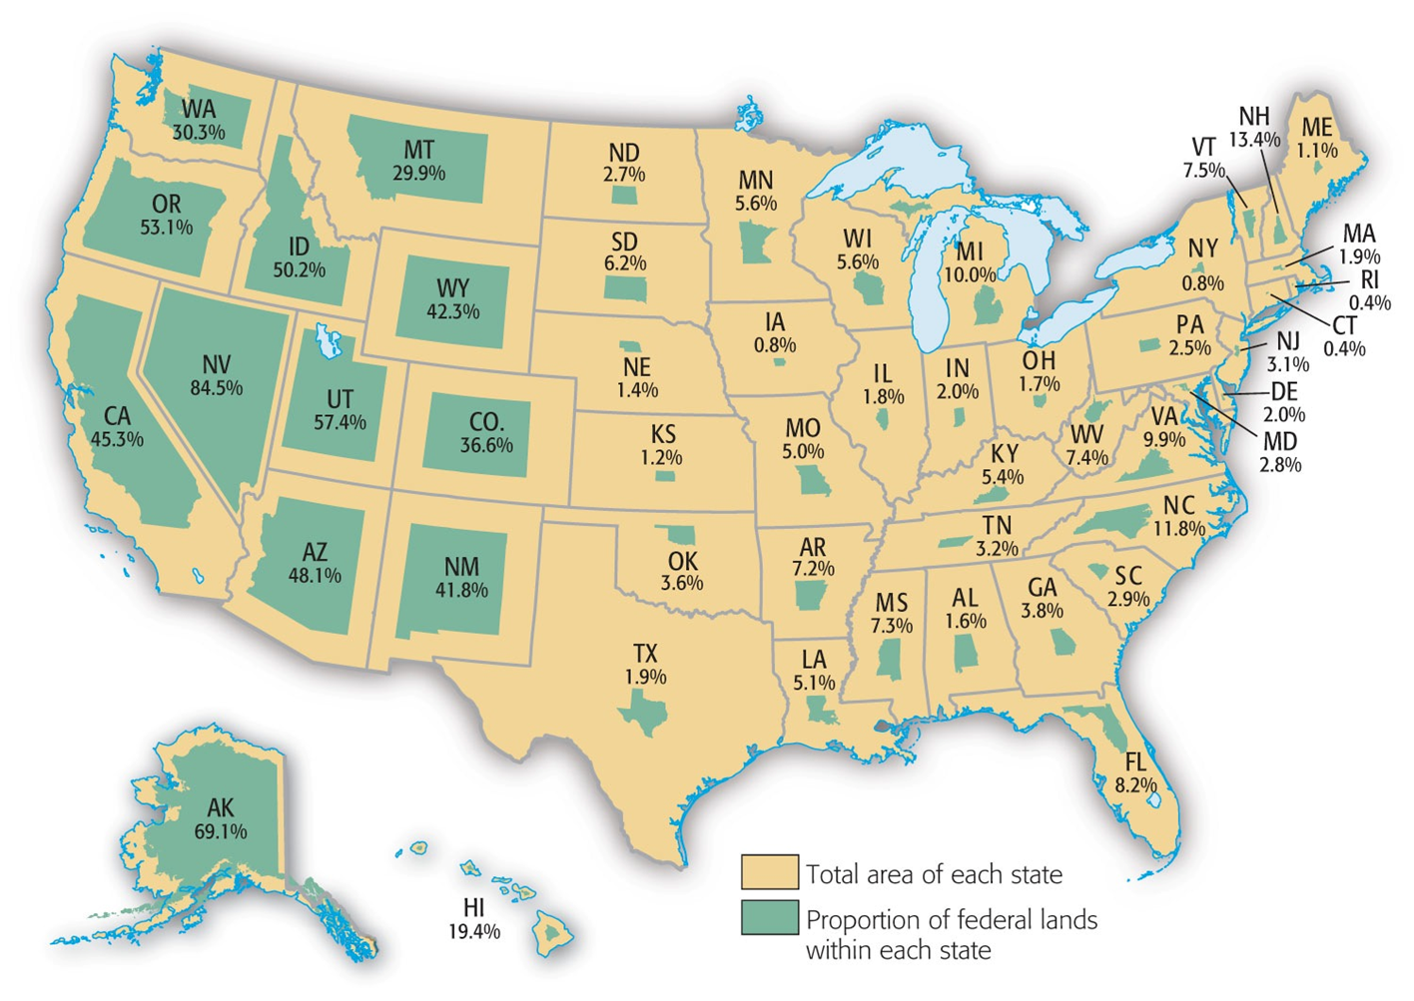
**1890 Census**
Used in Frederick Jackson Turner’s thesis
For first time in US history, frontier line was no longer discernible
Safety-valve theory:
Supposedly, during depressions, city unemployed moved west to farm and prospered.
In reality, few city folk in eastern centers migrated to frontier during depressions.
In fact, near century’s end, many farmers moved to the city.
Reality = in no other region had the federal government played so conspicuous a role in economic and social development.

Slide 7
One More Term To Know
"Crop lien" system: basis of the commercialization of southern agriculture.
A planter or merchant extended a line of credit (at high interest rates, 8-40%) to a struggling farmer.
Impossible for farmer to get out of debt.
Growing a single cash crop
Resulted in many poor white AND black farmers becoming landless tenant farmers or sharecroppers.
Pitted farmers against Wall St. bankers.

Slide 8
Politics of the 1890s

Slide 9
The Grange
The National Grange of the Patrons of Husbandry—better known as “the Grange”
Provided social and economic opportunities for FARMERS
Prelude to Farmers’ Alliance (which is a prelude to Populists)
Together they sought to end monopolies in RR and grain storage, wanted government ownership of businesses, increased $ supply.
Ultimately divided by race (long-standing divisions among southern farmers).

Slide 10
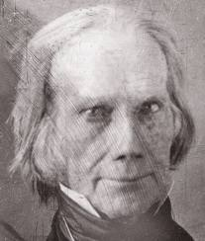
That’s it!
Visit apushreview.com
Help spread the word
Questions? Comments? Ideas for videos?
Email or leave in comments
Every time you don’t spread the word, I get uglier……

